Slide 1


BASRAH UNIVERSITY
Faculty of Education for Pure Sciences
Biology Department
2025- 2026
Lecture 4
Presented By: Prof. Dr. Sabeeh H. AL-Mayah

Slide 2
Phylum Apicomplexa (protozoa)
Members of this phylum are all parasites. These are either intra or intercellular parasites.
Without motile organelles as adult.
They are unique due to a complex arrangement of organelles at one end of the cell
They receive their name because the apex of the cells of certain life stages of these parasites has intricate (complex) structures that enable these parasites to penetrate the tissues of their hosts

Slide 3
Phylum Apicomplexa
1. All are endoparasites; hosts are in many animal phyla.
2. An apical complex is a feature of this phylum; it is present only in certain stages.
3. Rhoptries and micronemes help it penetrate the host’s cells.
4. Pseudopodia occur in some stages; gametes may be flagellated, and contractile fibrils may form waves to propel it through liquid.
5. The life cycle usually includes both sexual and asexual stages; a vertebrate may be an intermediate host.
6. At some point, they form a spore (oocyst) that is infective the
next host and protects the sporozoan .

Slide 4
Subphylum : Sporozoa
Class Telosporea Telosporea is the most important class; it contains two orders.
1) Eucoccidia are includes Plasmodium spp.( which infect various species of vertebrates )and Toxoplasma gondii which are important intracellular parasites in both invertebrate and vertebrates .
2) Eugregariniada includes Monocystis spp. which are common parasites of invertebrates (one host only) but are of little economic import.

Slide 5
Plasmodium: The Malarial Organism
1) Malaria is the most important infectious disease of humans.
2) Four species infect humans: P. Falciparum , P. vivax , P. malariae and P. ovale ; each produces different clinical symptoms.
3) Anopheles mosquitoes carry all forms; the female injects the sporozoites in her saliva.
4) Sporozoite penetrate liver cells and initiate schizogony.

Slide 6
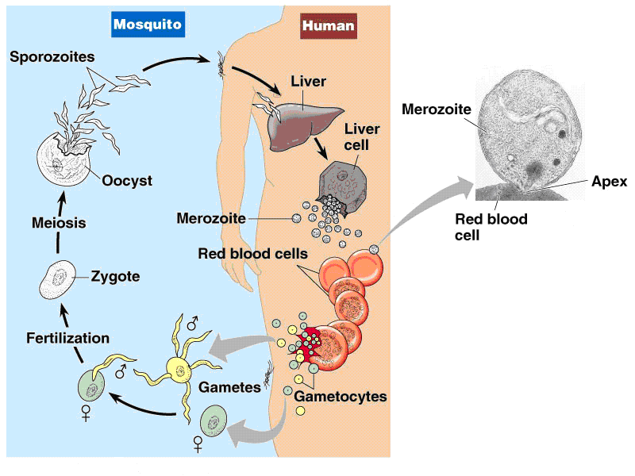
Plasmodium life cycle in humans
The sporozoites leave the bloodstream and penetrate liver cells, where they undergo schizogony (asexual cleavage multiplication) and produce merozoites
Merozoites released as a result of liver schizogony enter red blood cells, where they become ameboid trophozoites, feeding on haemoglobin
A trophozoite within a red blood cell grows and undergoes schizogony producing merozoites. The host red blood cell ruptures, releasing the merozoites as well as metabolic wastes that are responsible in large part for the characteristic symptoms of malaria. Many merozoites enter and infect more red blood cells, with the cycle repeating until an enormous number of host cells have become parasitized
After several such sexual generations, some of the merozoites enter red blood cells to become sexual forms called macrogametocytes and microgametocytes. These may be picked up by a feeding Anopheles female. The gametocytes mature within the mosquito to gametes, and fertilization occurs. The resulting zygote divides to produce sporozoites, which migrate to the mosquito salivary glands. When this mosquito bites another human, the sporozoites will be injected along with saliva into the blood of the human and the cycle begins again

Slide 7
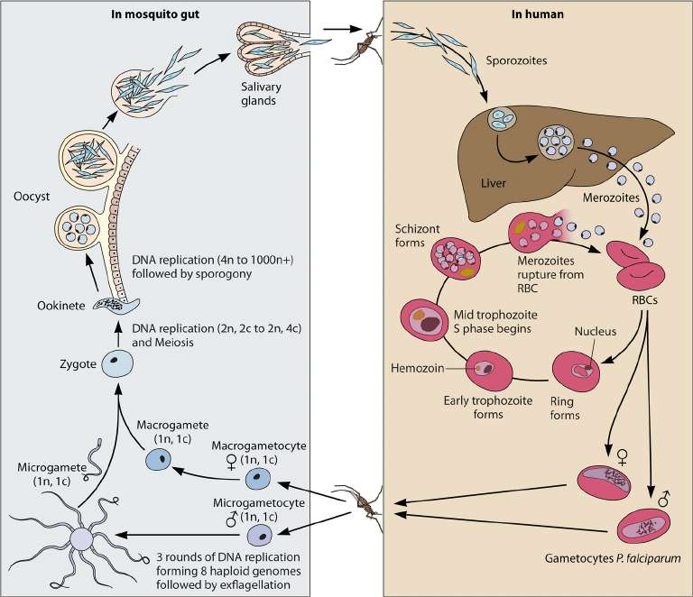

Slide 8
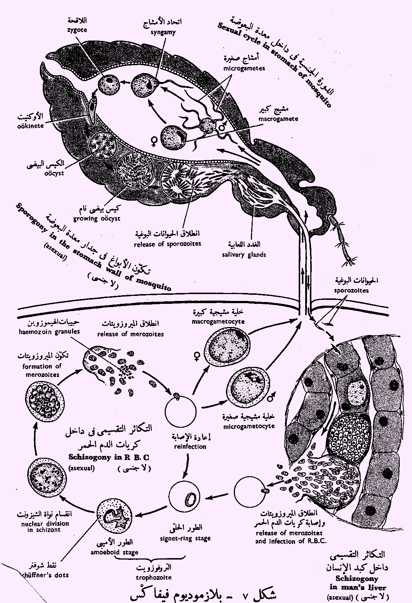

Slide 9
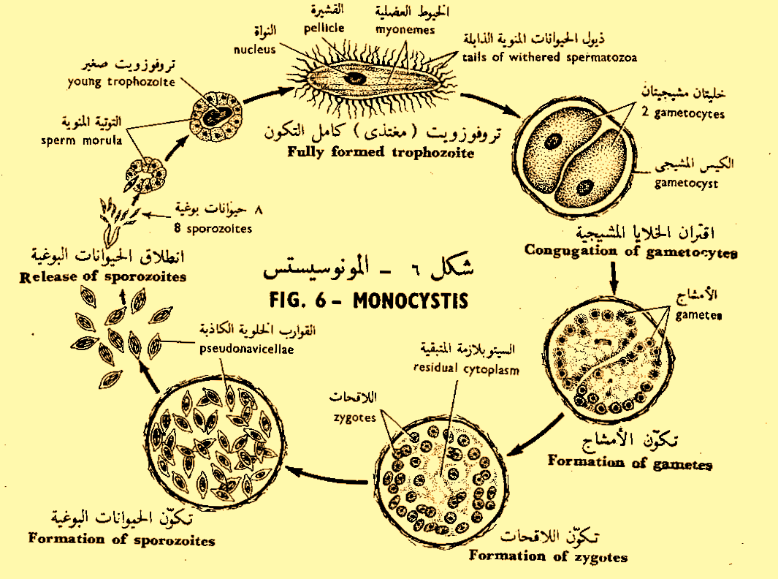

Slide 10
Differences between Plasmodium & Monocystis
Plasmodium
Monocystis
Trophozoite live intracellularly
The male and female gametes are different
The zygote is motile
The sporozoites are naked
Trophozoite live intercellularly
Isogametes
The zygote is sessile
The sporozoites surrounded by cyst called pseudonavicella

Slide 11
Toxoplasma gondii is a parasite of cats.
1) Rodents, cattle, sheep, birds and humans can ingest sporozoites.
2) They cross the intestine and asexually reproduce in tissues.
3) As the host builds immunity, the zoites enclose in tough tissue cysts called bradyzoites.
4) Up to half of the U.S. population carries tissue cysts from eating undercooked meat.
5) Toxoplasmosis is a serious threat during pregnancy; 2% of the cases of mental retardation may be due to congenital toxoplasmosis.

Slide 12
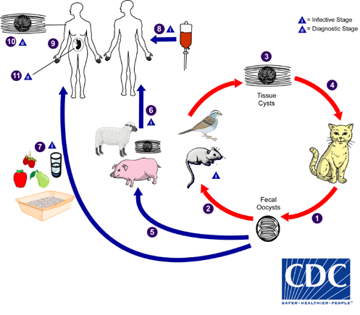

Slide 13
Phylum Ciliophora
Ciliophora (or Ciliates) represents a phylum of protozoa characterized, in at least one stage of development, by simple or compound ciliary organelles on the surface of their membranes that are used for locomotion
Cilia are used as locomotor or food-acquiring organelles. The arrangement of cilia varies within the phylum and some ciliates lack cilia as adults, although they are present at other stages in their life cycles
Cilia may cover evenly the entire outer surface of the protozoan, or they may join to form cirri, which are used in movement. Alternatively, cilia may be lost from large regions of a ciliate

Slide 14
Phylum Ciliophora contd:
Trichocysts are pellicular structures primarily used for protection. They are rodlike or oval organelles oriented perpendicular to the plasma membrane
They are explosively expelled upon mechanical or chemical stimulation
They function in defense against predators

Slide 15
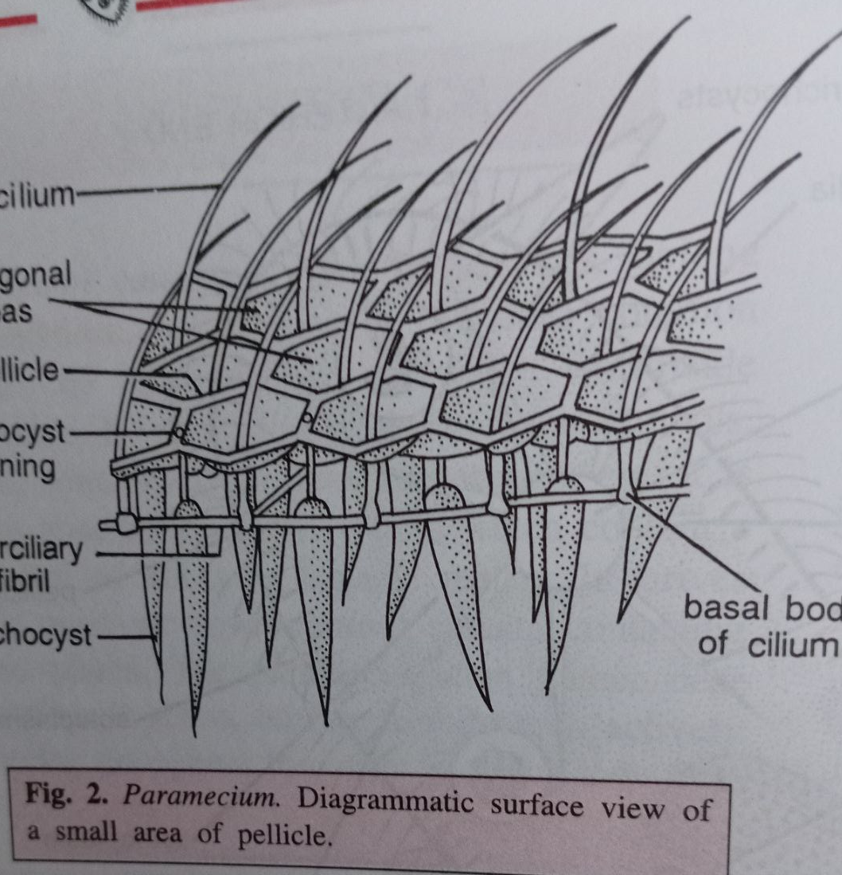
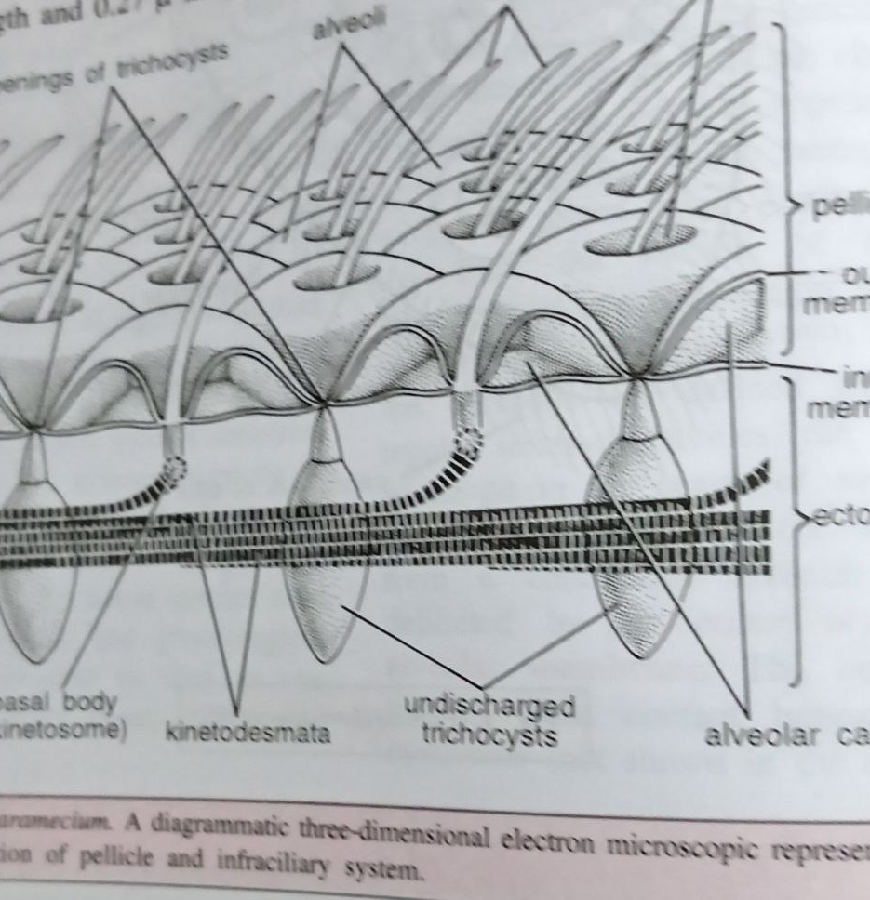

Slide 16
Phylum Ciliophora contd:
Ciliates have relatively rigid pellicle and more or less fixed shape. They have distinct mouth structure, and they have dimorphic nuclei, typically a larger macronucleus and one or more smaller micronuclei
Macronucleus mediates the day-to-day functioning of the cell including synthesis of RNA and DNA
Micronucleus is involved primarily in DNA synthesis but is also involved in the sexual processes (conjugation, autogamy, cytogamy) undergone by ciliates
Notes:
Autogamy (self-fertilization) process that occurs in one organism. cytogamy is another type of self-fertilization where two organisms join together but do not undergo nuclear exchange.

Slide 17
Phylum Ciliophora contd:
Ciliates possess typical mouth (or cytostome), although it has been secondarily lost in some groups
Many ciliates are filter feeder, collecting organisms from ambient currents or from currents produced by the ciliate
Food may include bacteria and detritus as well as other protozoa

Slide 18
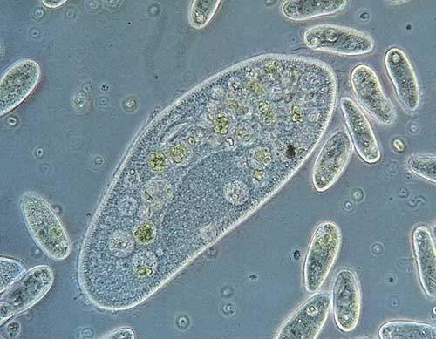
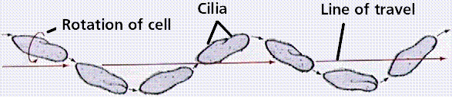
Animal-like protists - Examples
Paramecium
Unicellular, slipper-shaped
move by coordinated beating of many cilia
aquatic - mostly found in ponds and streams
usually do not cause diseases in humans
Notes:
http://www.micrographia.com/specbiol/protis/homamoeb/amoe0100.htmhttp://www.micrographia.com/specbiol/protis/homamoeb/amoe0100.htm
http://www.emc.maricopa.edu/faculty/farabee/BIOBK/BioBookDiversity_3.html

Slide 19
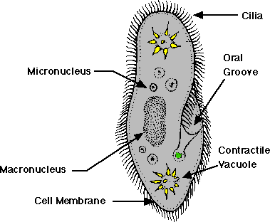
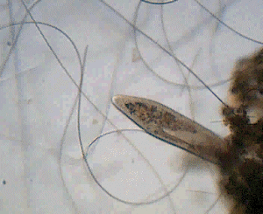
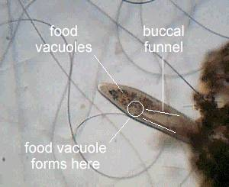
Animal-like protists - Examples
Paramecium - continued
Feeding occurs in the funnel-shaped gullet (buccal cavity) where food is drawn in by external and internal cilia to form food vacuole
ingests organic detritus and other small organisms like bacteria and other protozoans
Notes:
www.ittiofauna.org/.../ pg_07.htm
http://www.micrographia.com/specbiol/protis/cili/cili0100/parmov01.htm
http://www.kent.wednet.edu/staff/rlynch/sci_class/chap09/lesson_protista/Paramecium_Anatomy.html

Slide 20
Reproduction in the ciliates
Asexual reproduction is by binary fission
Sexual reproduction occurs when two ciliates of opposite mating types pair and exchange genetic materials
Conjugal contact triggers meiosis in the micronuclei resulting in 4 haploid micronuclei. Concurrently, the macronucleus breaks down and disappears

Slide 21
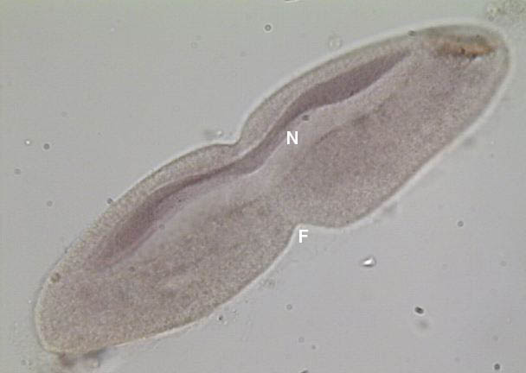
Animal-like protists - Examples
Paramecium - continued
Reproduction
1. Binary fission (________)
asexual
nucleus
N =
F =
Fission plane
Notes:
http://www.lima.ohio-state.edu/biology/biodiv/webproto.htm
http://www.lima.ohio-state.edu/biology/biodiv/proto/parafis.jpg

Slide 22
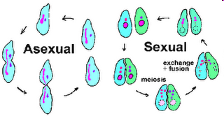
Notes:
Conjugal contact triggers meiosis in the micronuclei resulting in 4 haploid micronuclei. Concurrently, the macronucleus breaks down and disappears. Three of the micronuclei disintegrate and the remaining micronucleus divides again. Each of the conjugating organisms donates a micronucleus (gametic or male) to its mate via a cytoplasmic bridge that connects them. The gametic micronucleus fuses with the stationary (or female) micronucleus forming the diploid zygotic micronucleus. The conjugating pair separates and the zygotic nucluei undergo another round of division. One of these micronuclei develops into the macronucleus, thus completing the cycle.

Slide 23
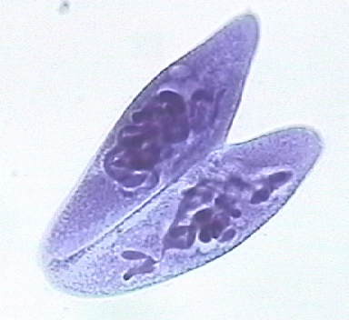
Animal-like protists - Examples
Paramecium - continued
Reproduction
2. Conjugation (________)
sexual
Form structure called conjugation tube to exchange genetic material
Notes:
http://faculty.clintoncc.suny.edu/faculty/Michael.Gregory/files/Bio%20102/Bio%20102%20Laboratory/Protists/protists.htm
http://faculty.clintoncc.suny.edu/faculty/Michael.Gregory/files/Bio%20102/Bio%20102%20Laboratory/protists/paramecium_multimicronulleatum_conjugating_X_200.JPG

Slide 24
Reproduction in the ciliates contd:
Each of the conjugating organisms donates a micronucleus (gametic or male) to its mate via a cytoplasmic bridge that connects them. The gametic micronucleus fuses with the stationary (or female) micronucleus forming the diploid zygotic micronucleus
The conjugating pair separates, and the zygotic nuclei undergo another round of division. One of these micronuclei develops into the macronucleus, thus completing the cycle

Slide 25
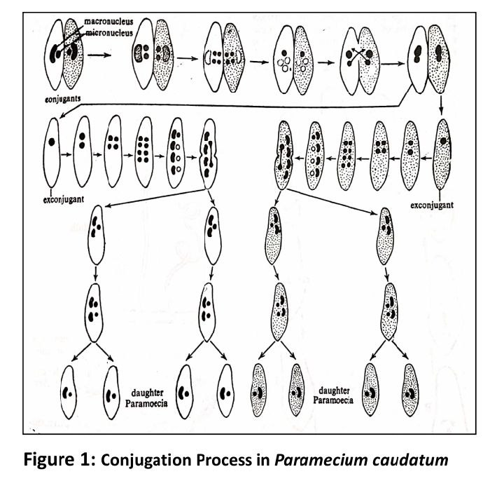

Slide 26
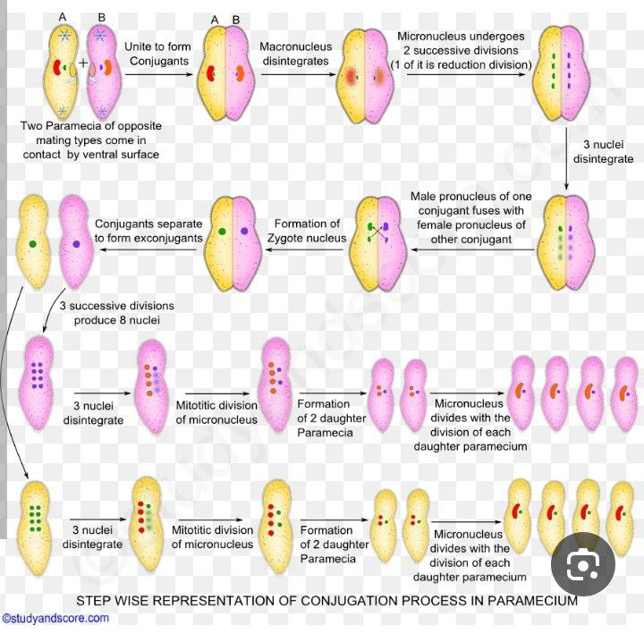

Slide 27
Suctorian ciliates
Suctorians are ciliates which do not at first sight resemble the usual ciliates, but they are classified amongst them as they have ciliated larvae, and also have the nuclear dualism characteristic of the other ciliates
The adult forms have no cilia but possess long hollow contractile tentacles through which they suck the contents of the prey organism. The tentacle secretions paralyze the prey and digest an opening in the pellicle of the prey
Prey cytoplasm is then drawn into the suctorian through tiny channels in the tentacle
Suctorians live attached to their substrate

Slide 28
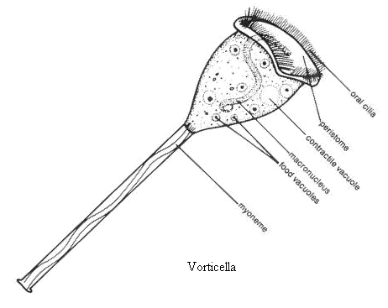
Vorticella are sessile ciliates as adults
However, young Vorticella are free-swimming
Adult forms attach to substrates with contractile stalks.
Adults can also be free-swimming if these stalks are cut
They can also detach themselves if food supplies are scarce and they need to find a new location
Vorticella are referred to as Peritrichs, meaning that their cilia are concentrated around the mouth end of the organism, but nowhere else on the body
If Vorticella becomes motile, temporary cilia will form around the body. However, once the organism has anchored itself, these cilia will disappear. Vorticella are heterotrophic organisms preying on bacteria

Slide 29
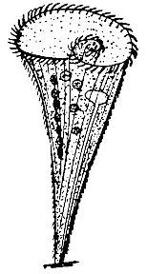
Stentor
Stentor is a free living heterotrich ciliate, with an elongated multilobed macronucleus and several micronuclei
They are referred to as heterotrichs because they have different cilial structures on different parts of their bodies
Stentor usually attaches to substrates and form a trumpet shape. With many myonemes, it can contract into a ball. It may swim freely both extended and contracted
Stentor are omnivorous heterotrophs. Typically, they feed on bacteria or other protozoans

Slide 30
Symbiotic Ciliates
Most ciliates are free living; however, some are commensalistic or mutualistic, and a few are parasitic. Balantidium coli is the largest protozoan and the only ciliate known to parasitize humans
Balantidium coli most commonly infects humans and pigs leading to a disease called Balantidiasis. Infection is likely to occur where humans live closely with swine and where water sanitation is poor or non-existent
Balantidium coli cysts are released in the feces of infected hosts. Consequently, Balantidium coli is transmitted by a fecal-oral route: humans are infected by ingestion of water or food contaminated by feces containing the protozoa
Large numbers of different species of ciliates also inhabit the rumen of many ungulates. These ciliates aid in the digestive process of their hosts

Slide 31


Slide 32
Thank You!

